Slide 1
Object Oriented Software Engineering (OOSE)
22CS017
Software Project Estimation
Prepared By: Dr. Vijaita Kashyap

Slide 2
Index
What is Estimation
COCOMO Model
Estimation of Object-Oriented Projects
Practice Questions

Slide 3
What is Estimation
Empirical estimation models are mathematical models used to estimate the effort, time, and cost required to complete software development projects. These models are derived from historical project data and provide a systematic way to predict resources and timelines.

Slide 4
Empirical Based Estimation – COCOMO Model
COCOMO (Constructive Cost Model) is a regression model based on LOC, i.e number of Lines of Code. It is a procedural cost estimate model for software projects and often used as a process of reliably predicting the various parameters associated with making a project such as size, effort, cost, time and quality. It was proposed by Barry Boehm in 1970 and is based on the study of 63 projects, which make it one of the best-documented models.
The key parameters which define the quality of any software products, which are also an outcome of the COCOMO model are:
Effort: Amount of labor that will be required to complete a task. It is measured in person-months units.
Schedule: Simply means the amount of time required for the completion of the job, which is, of course, proportional to the effort put. It is measured in the units of time such as weeks, months.

Slide 5
COCOMO Model
Different models of COCOMO have been proposed to predict the cost estimation at different levels, based on the amount of accuracy and correctness required. All of these models can be applied to a variety of projects, whose characteristics determine the value of constant to be used in subsequent calculations.
SOFTWARE PROJECT TYPES:
Organic – A software project is said to be an organic type if the team size required is adequately small, the problem is well understood and has been solved in the past and also the team members have a nominal experience regarding the problem.

Slide 6
COCOMO Model
Semi-detached – A software project is said to be a Semi-detached type if the vital characteristics such as team-size, experience, knowledge of the various programming environment lie in between that of organic and Embedded. The projects classified as Semi-Detached are comparatively less familiar and difficult to develop compared to the organic ones and require more experience and better guidance and creativity.
Embedded – A software project with requiring the highest level of complexity, creativity, and experience requirement fall under this category. Such software requires a larger team size than the other two models and also the developers need to be sufficiently experienced and creative to develop such complex models.
All the above system types utilize different values of the constants used in Effort Calculations.

Slide 7
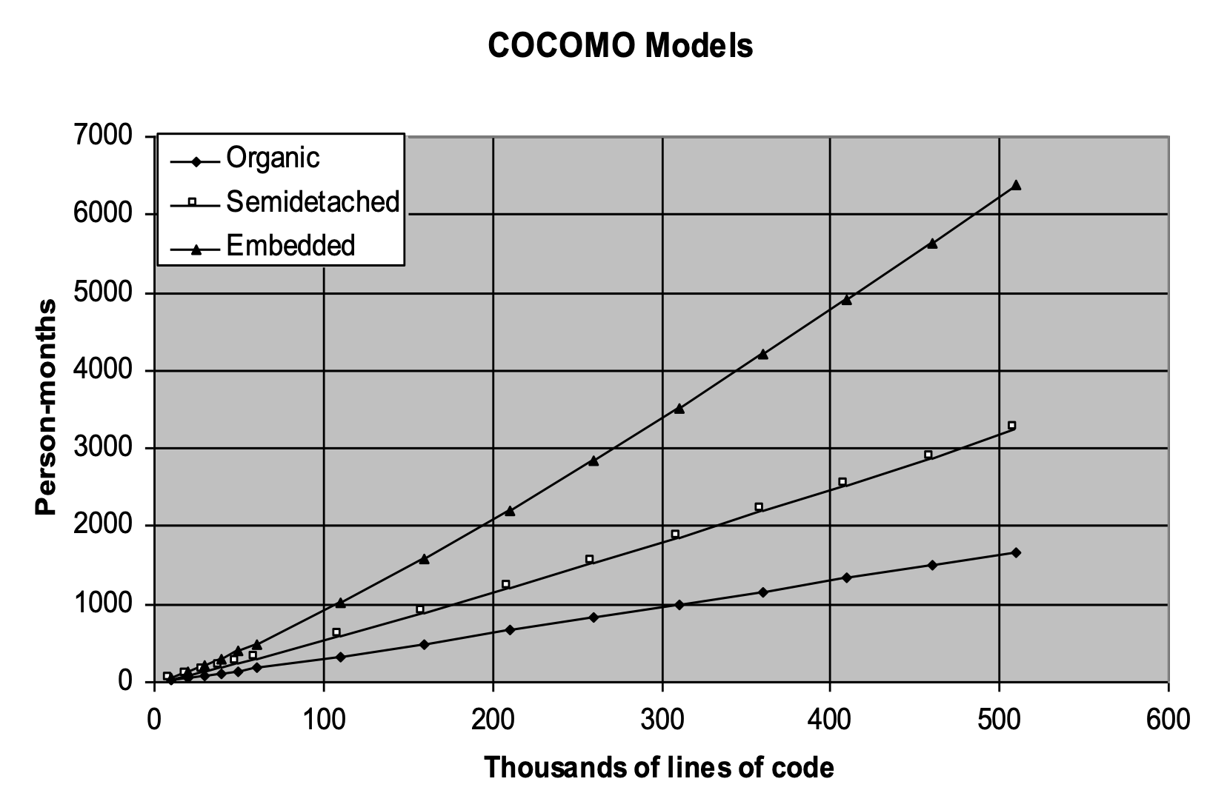
COCOMO Model
Figure 1: Graph of COCOMO Model

Slide 8
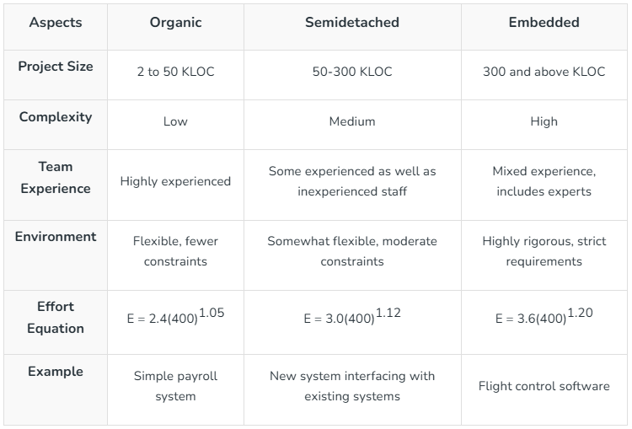
Comparison of Types of Projects in COCOMO Model

Slide 9
COCOMO Model Types
COCOMO consists of a hierarchy of three increasingly detailed and accurate forms:
Basic COCOMO Model
Intermediate COCOMO Model
Detailed COCOMO Model
The first level, Basic COCOMO can be used for quick and slightly rough calculations of Software Costs. Its accuracy is somewhat restricted due to the absence of sufficient factor considerations.
Intermediate COCOMO takes these Cost Drivers into account and Detailed COCOMO additionally accounts for the influence of individual project phases, i.e in case of detailed, it accounts for both these cost drivers and also calculations are performed phase wise henceforth producing a more accurate result.

Slide 10
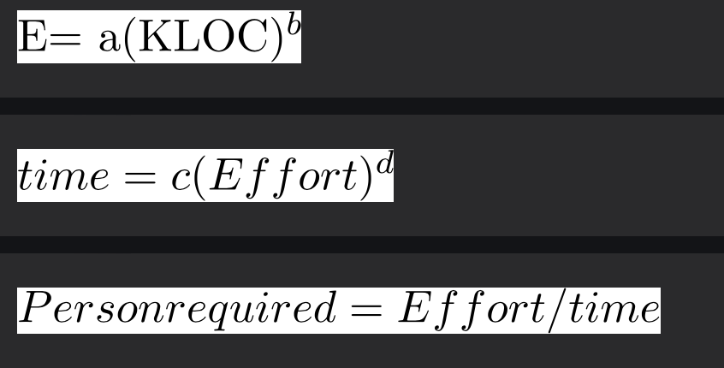
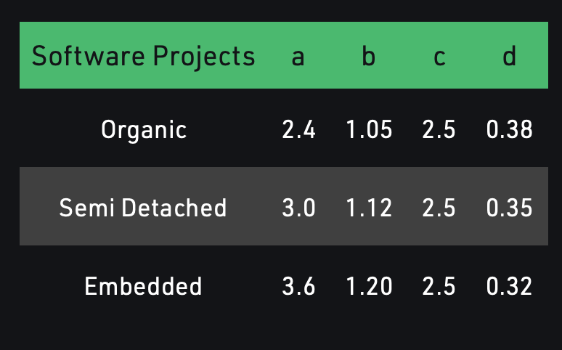
Basic Model - Estimation of Effort
The above formula is used for the cost estimation for the basic COCOMO model, and also is used in the subsequent models.
The constant values a, b, c and d for the Basic Model for the different categories of system are given in table.
The effort is measured in Person-Months
As evident from the formula is dependent on Kilo-Lines of code (KLOC).
The development time is measured in months.

Slide 11
Basic Model - Estimation of Effort
Example1: Suppose a project was estimated to be 400 KLOC. Calculate the effort and development time for each of the three model i.e., organic, semi-detached & embedded.
Solution: The basic COCOMO equation takes the form:
Estimated Size of project= 400 KLOC
(i)Organic Mode
E = 2.4 × (400)^{1.05} = 1295.31 PM
D = 2.5 × (1295.31)^{0.38}=38.07 M
(ii)Semidetached Mode
E = 3.0 × (400)^{1.12}=2462.79 PM
D = 2.5 × (2462.79)^{0.35}=38.45 M
(iii) Embedded Mode
E = 3.6 × (400)^{1.20} = 4772.81 PM
D = 2.5 × (4772.8)^{0.32} = 38 M

Slide 12
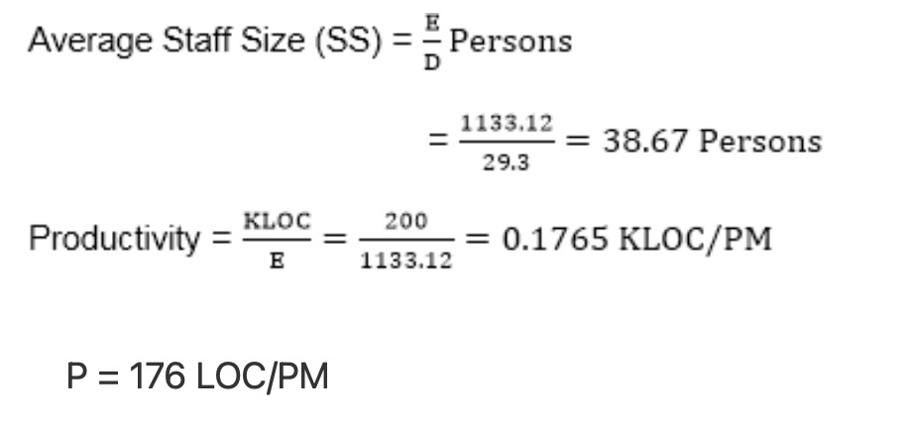
Basic Model - Estimation of Effort
Example 2: A project size of 200 KLOC is to be developed. Software development team has average experience on similar type of projects. The project schedule is not very tight. Calculate the Effort, development time, average staff size, and productivity of the project.
Solution: The semidetached mode is the most appropriate mode, keeping in view the size, schedule and experience of development time.
E = 3.0×(200)^{1.12} = 1133.12 PM D = 2.5× (1133.12)^{0.35} = 29.3 M

Slide 13
Intermediate Model - Estimation of Effort
The basic COCOMO model assumes that the effort is only a function of the number of lines of code and some constants evaluated according to the different software systems.
However, in reality, no system’s effort and schedule can be solely calculated on the basis of Lines of Code.
For that, various other factors such as reliability, experience, capability.
These factors are known as Cost Drivers
The Intermediate Model utilizes 15 such drivers for cost estimation.

Slide 14
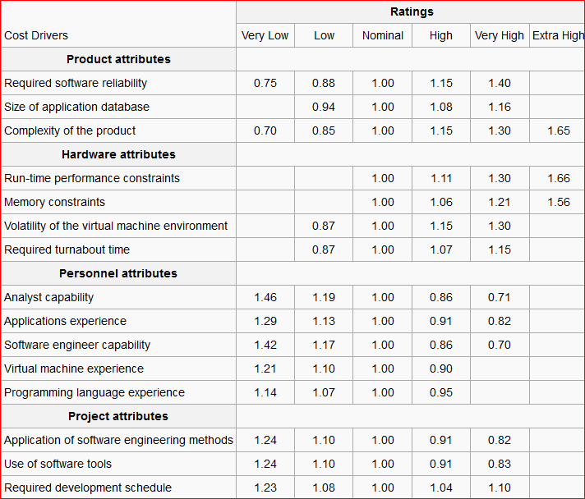
Intermediate Model - Estimation of Effort

Slide 15
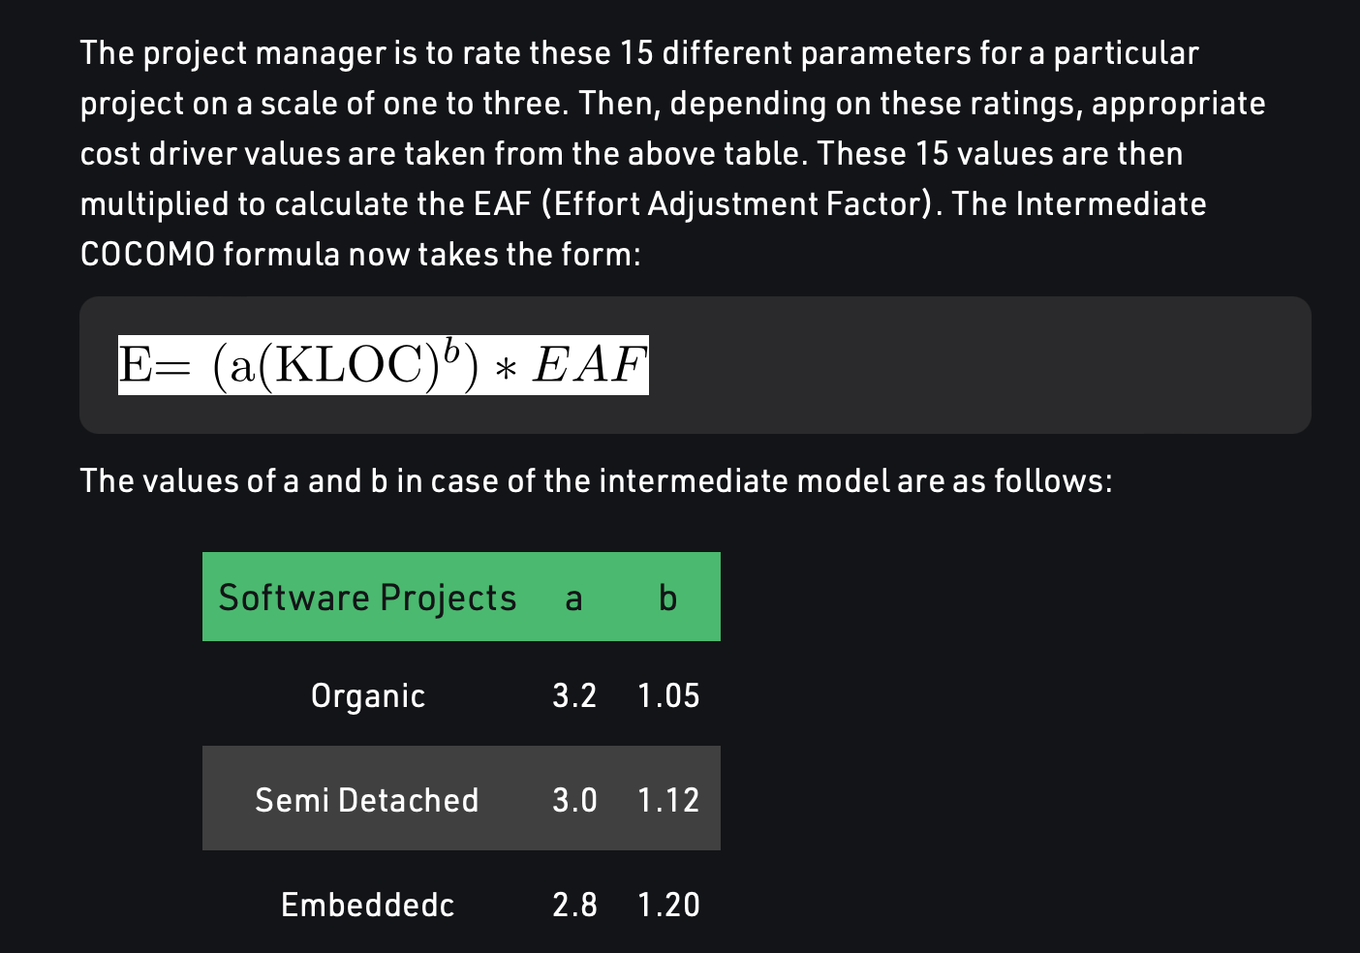
Intermediate Model - Estimation of Effort

Slide 16
Intermediate Model - Estimation of Effort
Example: For a given project was estimated with a size of 300 KLOC. Calculate the Effort, Scheduled time for development by considering developer having very high application experience and very low experience in programming.
Solution:
Given the estimated size of the project is: 300 KLOC
Developer having highly application experience: 0.82 (as per cost driver table)
Developer having very low experience in programming: 1.14 (as per cost driver table)
EAF = 0.82×1.14 = 0.9348
Effort (E) = a× (KLOC)^{b} ×EAF = 3.0× (300)^{1.12} ×0.9348 = 1668.07 MM
Scheduled Time (D) = c× (E)^{d} = 2.5× (1668.07)^{0.35} = 33.55 Months(M)

Slide 17
Detailed Model - Estimation of Effort
Detailed COCOMO incorporates all characteristics of the intermediate version with an assessment of the cost driver’s impact on each step of the software engineering process.
The detailed model uses different effort multipliers for each cost driver attribute.
In detailed COCOMO, the whole software is divided into different modules and then we apply COCOMO in different modules to estimate effort and then sum the effort.
The Six phases of detailed COCOMO are:
Planning and requirements
System design
Detailed design
Module code and test
Integration and test
Cost Constructive model

Slide 18
Estimation of Object-Oriented Projects
Object-oriented (OO) software estimation involves additional complexity due to the modular and reusable nature of objects. Standard estimation methods include:
Approaches:
Object Points – Counts screens, reports, and third-party components.
Use Case Points (UCP) – Estimates based on the complexity and number of use cases.
Class Point – Estimates based on the number of classes and their complexity.

Slide 19
Object Points
Object Points are a size metric used for early estimation of projects, especially GUI and event-driven applications.
What you count:
Screens (user interfaces)
Reports (output documents)
3rd-party components (reusable modules)
Steps:
Count the number of screens, reports, and components.
Classify each one as:
Simple, Medium, or Complex based on the number of fields, buttons, links, etc.
Assign a weight (points) for each type and complexity.
Adjust the total for reuse (if reusing existing components).

Slide 20
Use Case Point Estimation
Unadjusted Use Case Weight (UUCW): Sum of the complexity weights for all use cases.
Unadjusted Actor Weight (UAW): Sum of actor complexity weights.
Technical Complexity Factor (TCF): Adjusts effort based on technical challenges.
Environmental Factor (EF): Considers team skills and tools.
Effort Calculation Formula:
Effort (PM) = (UUCW + UAW) × TCF × EF
Components:
UUCW: Unadjusted Use Case Weight
UAW: Unadjusted Actor Weight
TCF: Technical Complexity Factor
EF: Environmental Factor

Slide 21
Class Point Estimation
Class Points estimate size based on class diagrams — it’s a bit more detailed than Object Points.
What you count:
Classes: each class in your UML diagrams.
Attributes and Methods inside classes.
Class Complexity: Simple, Medium, Complex
Weight Assignment: Apply effort weights
Effort Calculation: Sum of class weights adjusted by complexity factors
Challenges in OO Estimation
Inheritance & Reusability – Difficult to quantify reusable components.
Dynamic Behavior – Hard to capture due to polymorphism and dynamic binding.
Component Interaction – Increased complexity in estimating component dependencies.

Slide 22
Comparison: COCOMO vs OO Estimation
Feature | COCOMO Model | OO Estimation
Basis of Estimation | Lines of Code (KLOC) | Objects, Use Cases, Classes
Complexity Handling | Cost Drivers | Complexity factors (UCP, CP)
Flexibility | Procedural systems | Modern OO architectures
Accuracy | Large systems | Modular OO designs
Evolution | Advanced (COCOMO II) | Modern methods (Use Case Points)

Slide 23
Conclusion
COCOMO Model: Ideal for procedural systems using KLOC.
OO Estimation: Better for object-oriented systems.
Accurate estimation is crucial for project success.

Slide 24
Practice Questions
Q1. Suppose that a project was estimated to be 300 KLOC. Calculate effort & time for each of 3 modes of development.
Software Product Type | a | b | c | d
Organic | 2.4 | 1.05 | 2.5 | 0.38
Semi-detached | 3.0 | 1.12 | 2.5 | 0.35
Embedded | 3.6 | 1.20 | 2.5 | 0.32
How do you estimate the cost of a project?
What are some common cost estimating tools and techniques?
How do you develop a cost estimate for a new project?

Slide 25
Practice Questions:MCQs
What is the primary purpose of empirical estimation models?
A) Designing user interfaces B) Estimating effort, time, and cost of software projects C) Debugging complex software systems D) Managing software repositories
Answer: B) Estimating effort, time, and cost of software projects
In the Basic COCOMO model, what does 'KLOC' represent?
A) Key Level Object Components B) Kernel-Level Object Code C) Thousands of Lines of Code D) Knowledge Logic of Components
Answer: C) Thousands of Lines of Code
Which COCOMO model category is best suited for small, simple projects?
A) Semi-Detached B) Embedded C) Organic D) Modular
Answer: C) Organic

Slide 26
Practice Questions: MCQs Cont…
What is a key challenge when estimating object-oriented projects?
A) Lack of technical resources B) Inheritance and reusability C) Limited use of algorithms D) Ignoring system documentation
Answer: B) Inheritance and reusability

Slide 27
Bibliography
https://www.tutorialspoint.com/estimation_techniques/estimation_techniques_overview.htm
http://www.zeepedia.com/read.php?decomposition_techniques_estimation_tools_software_project_management&b=18&c=30
https://www.geeksforgeeks.org/software-engineering-cocomo-model/
https://study.com/academy/lesson/what-is-system-analysis-in-software-engineering.html
https://www.tutorialspoint.com/What-is-Data-Dictionary
https://www.lucidchart.com/pages/er-diagrams
https://www.datanamic.com/support/lt-dez006-what-is-an-erd.html

